Slide 1
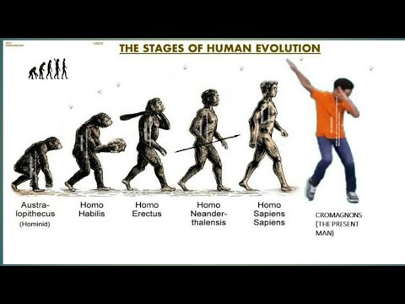
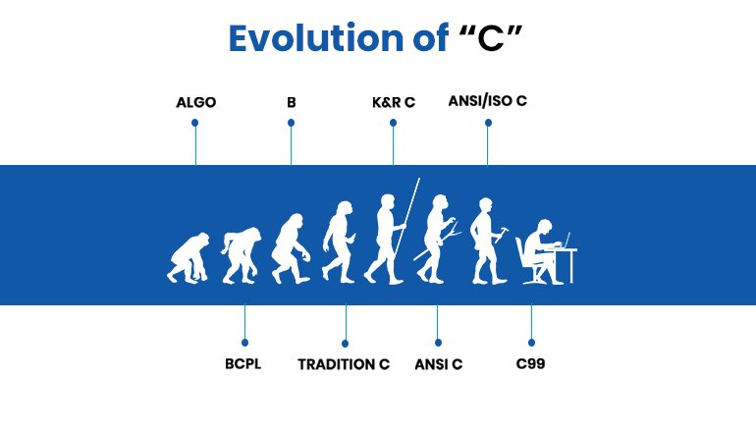
HOW ‘C’ EVOLVED?
DENNIS RITCHIE developed C in Bell Laboratories.
C is the successor of B Language.
UNIX OS was already written with B Language . But to overcome some difficulties, ‘C’ was developed and used .
In 1989, it is standardised by ANSI(American National Standards Institute) and so called as ANSI-C.
HOW HUMANS EVOLVED? HOW ‘C’ EVOLVED?

Slide 2
Low-Level Languages:
Machine Language→ Programs are written using 0’s and 1’s.
Advantage : Since the program is already written in Machine Language, no need of
conversion. So ,execution will be faster.
Disadvantage: 1. Machine Language is Machine- Dependent
2. Not understandable by Humans.
3. Programs are not portable.(If one program is written in one machine, the same program cannot be run on another machine ).
2. Assembly Language→ To overcome the above mentioned problems, Assembly Language is found .
Mnemonics are used here.
Eg: ADD , SUB , MV etc
This has to be converted to machine language by assembler.

Slide 3
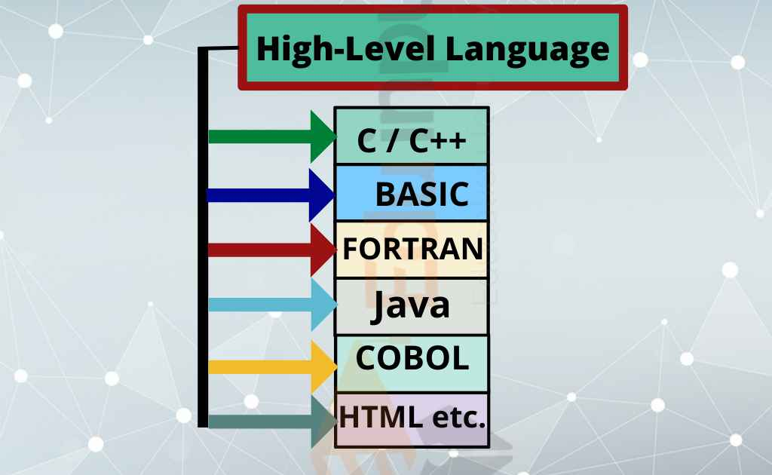
High-Level Language:
1. Programs written using High-Level Languages are portable and are not Machine- dependent.
2. It deals with Functions , Loops , etc and is easily understandable as it is written in Normal English.

Slide 4
FEATURES OF C LANGUAGE:
1. High-level Language
2. Portable
3. Structured Language
4. Uses Pointers( Stores the address of variable)
5. Extensible Language(We can add our own features and functions)
6. Compilation and Execution is faster.
7. Case-sensitive
8. Dynamic Memory Allocation.
9. Small language having 32 Keywords.
APPLICATIONS:
1. Operating System
2. Editors
3. File utilities
4. Performance enhancers
5. Real time executives

Slide 5

LANGUAGE TRANSLATORS: Programs written in many languages like Python, C, Java etc has to be converted into machine language. 1. COMPILER : It takes complete source code. 2. INTERPRETER: It reads line by line then executes that program.
COMPILER | INTERPRETOR
High Level Language→ COMPILER→ Machine code. | High Level Language→ INTREPRETOR→ Machine Code.
→ COMPILER→ Object Code filename.C | → INTREPRETOR→ Machine Code 1. No object code will be created. 2. Execution and Translation runs parallely . 3. Finding out errors is easy in this. 4. Every time it needs source code.
Eg: A Hindi film dubbed in English subtitles can be watched fully. | Eg: If Russian PM speaks Russian, then a translator translates each line of Russian to Hindi to be understood by our PM.

Slide 6
EXECUTION OF C PROGRAM:

Slide 7
STRUCTURE OF C PROGRAM:
1. DOCUMENTATION SECTION→ It tells what’s the program is about and also includes the details of the Author, Date etc using comment lines. Eg: //Author( Single Comment line) /* Program for addition of two numbers.*/ (Multiple Line comments)
2. LINK SECTION→
1. #include<stdio.h> (Standard input and output). This stdio file includes printf(For output) and scanf(for input) 2. #include<conio.h> ( Console input output) . This includes getch() .
3. DEFINITION SECTION→ #define PI 3.14159 (This means wherever in a program when PI is found, it will be defined or replaced by 3.14159.

Slide 8
4. GLOBAL DECLARATION SECTION→
LOCAL VARIABLES :- Used within specifie function. Eg: void sum() { int a; } main()
GLOBAL VARIABLES:- Declared outside a function. Eg: int a; void sum(); void sub();
5. MAIN SECTION→ Only one main function should be there in a program . void main() { Declaration Execution( Logic Part) }
6. SUB PROGRAM SECTION.

Slide 9
PROGRAM INCLUDING ALL THE SECTIONS:
#include<stdio.h> #include<conio.h> #define MAX 100 int a=50; void display(); // declaration of user-defined function void main() { printf(“Hello”); display(); //calling of function getch() // to hold the output screen void display() // definition of function { printf(“Welcome”); }

Slide 10
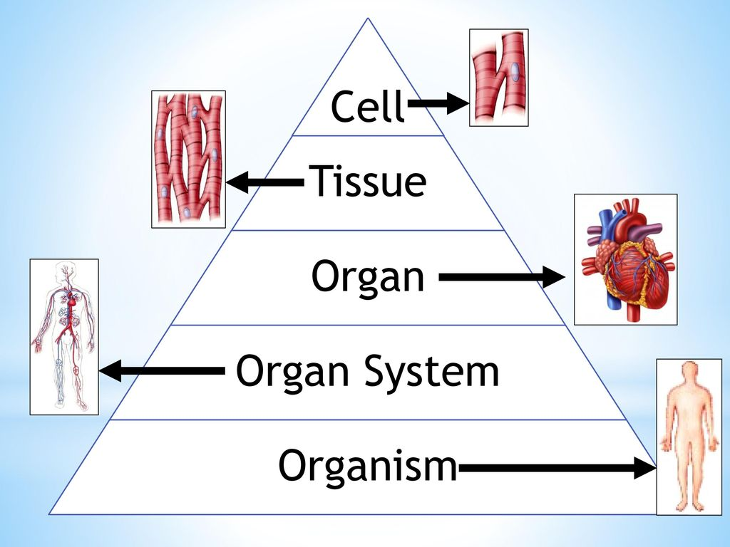
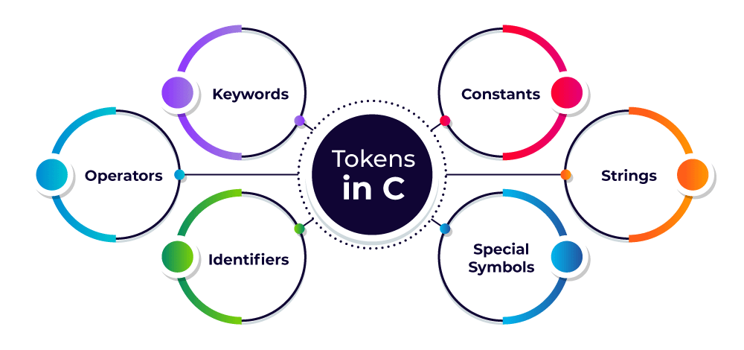
TOKEN
A cell is defined as the smallest, basic unit of life that is responsible for all of life’s processes.
TOKENS are the basic building blocks of a program.
Likewise

Slide 11
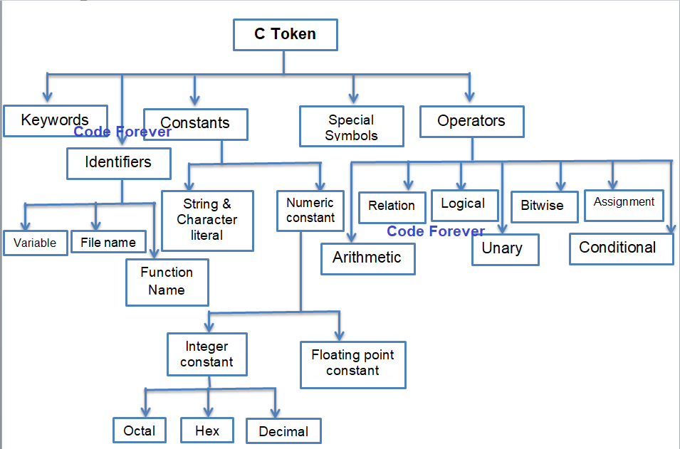

Slide 12
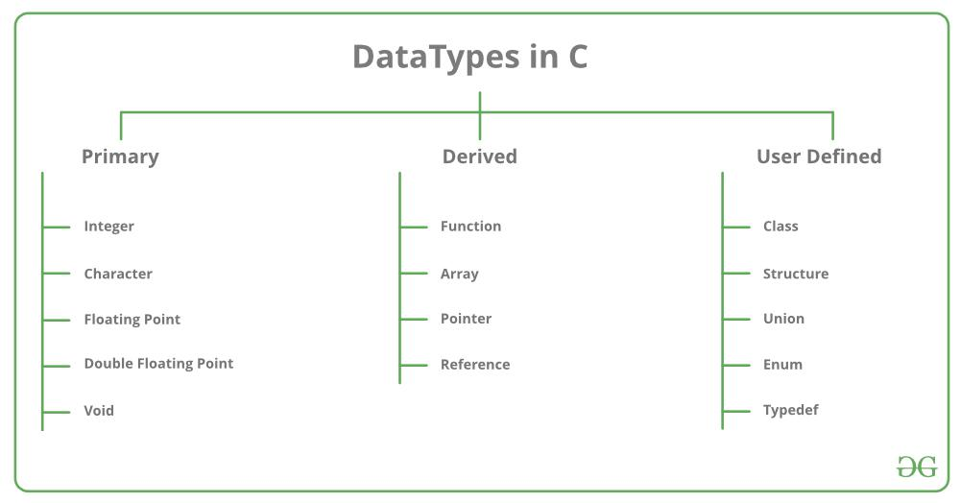
DATA TYPES:
It tells you the type of data you have to store in memory and also how much memory to be allocated to the data.
NOTE:
16-bit is a computer device or program capable of transferring 16 bits of data at a time.
32-bit tells us that the number of bits that can be processed or transmitted. In another way, you can say that the number of bits that can be used for the single element in a data format.

Slide 13
The FIVE basic data types in C are:
character - Keyword used is char
Integer - Keyword used is int
floating point - Keyword used is float
Double precision floating point - Keyword used is double
Valueless - Keyword used is void
16-BIT COMPUTER 32-BIT COMPUTER
DATA TYPE | SIZE ( in bits) | RANGE
char | 8 | -128 to 127
int | 16 | -32768 to 32767
float | 32 | 1.17549 X 10⁻³⁸ to 3.40282 X 10³⁸
double | 64 | 2.22507 X 10⁻³⁰⁸ to 1.79769 X 10³⁰⁸
void | 8 | valueless
DATA TYPE | SIZE (in bits) | RANGE
char | 8 | -128 to 127
int | 32 | -2147483648 to 2147483647
float | 32 | 1.17549 X 10⁻³⁸ to 3.40282 X 10³⁸
double | 64 | 2.22507 X 10⁻³⁰⁸ to 1.79769 X 10⁻³⁰⁸
void | 8 | valueless

Slide 14
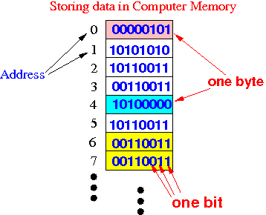
SNEAK-PEAK ABOUT COMPUTER MEMORY:
A Computer provides a Random Access Memory (RAM) for storing the executable program code and the data the program manipulates.
A Computer Memory is made up of Registers and Cells which are capable of holding information in the form of binary digits 0 and 1(bits).
It accesses data as a collection of bits like 8 bits, 16 bit, 32 bit or 64 bit.
Data is stored in the memory at physical memory locations.

Slide 15
There are specifiers and qualifiers for the data types such that: Size specifiers → short and long Sign specifiers → signed and unsigned Type qualifiers → const , volatile and restrict.
SIZE SPECIFIERS:
The size specifiers are used with the data type int; these are short and long.
short int tells the C compiler that the particular variable being declared is used to store fairly small integer values.
This conserves memory space.
Similarly, long int is used to store large integer values.
 | 16-bit machine | 32-bit machine | 64-bit machine
short int | 2 | 2 | 2
int | 2 | 4 | 4
long int | 4 | 4 | 8

Slide 16
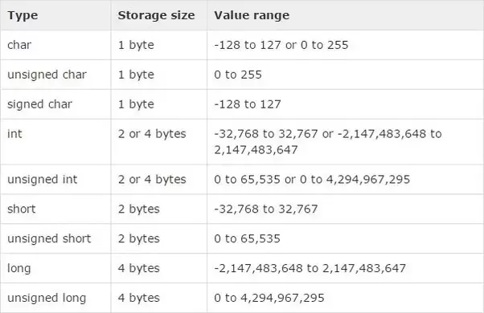
SIGN SPECIFIERS:
The term “unsigned” indicates a variable that can hold only positive numbers.
The term “signed” indicates that a variable can hold negative and positive values.
This can be applied to most of the numeric data types including int, char, short and long.

Slide 17
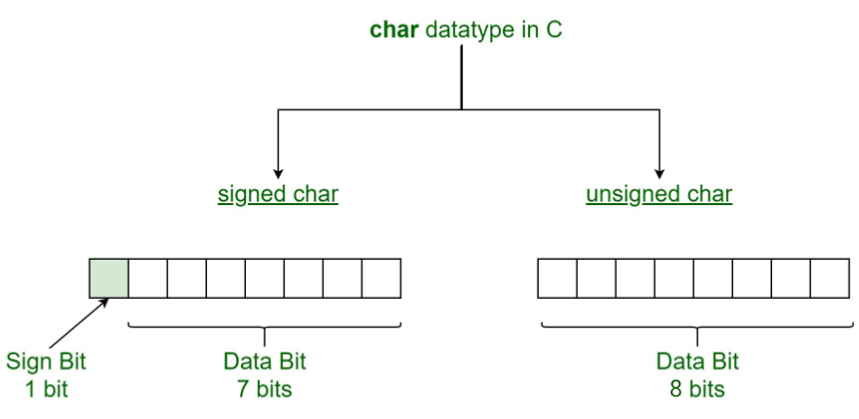
UNSIGNED AND SIGNED CHAR:-
unsigned char is a character datatype where the variable consumes all the 8 bits of the memory and there is no sign bit (which is there in signed char). So it means that the range of unsigned char data type ranges from 0 to 255.
As we know , The basic ASCII values are in range 0 to 127. The rest part of the ASCII is known as extended ASCII. Using char or signed char we cannot store the extended ASCII values. By using the unsigned char, we can store the extended part as its range is 0 to 255.

Slide 18








The range of unsigned char is 0 to 255.
0 255
0 | 0 | 0 | 0 | 0 | 0 | 0 | 0
1 | 1 | 1 | 1 | 1 | 1 | 1 | 1
2⁷ | 2⁶ | 2⁵ | 2⁴ | 2³ | 2² | 2¹ | 2⁰
How to identify the output for the input that does not lies within the range??
If the value is lesser than the range, move in reverse from the maximum range according to the given value.
0
1
2
.
.
.
255
Eg 1: void main()
{
unsigned char ch;
ch = -1;
printf(“%d”,ch);
}
OUTPUT: 255
Eg 2: void main()
{
unsigned char ch;
ch=256;
printf(“%d”,ch);
}
OUTPUT: 0

Slide 19
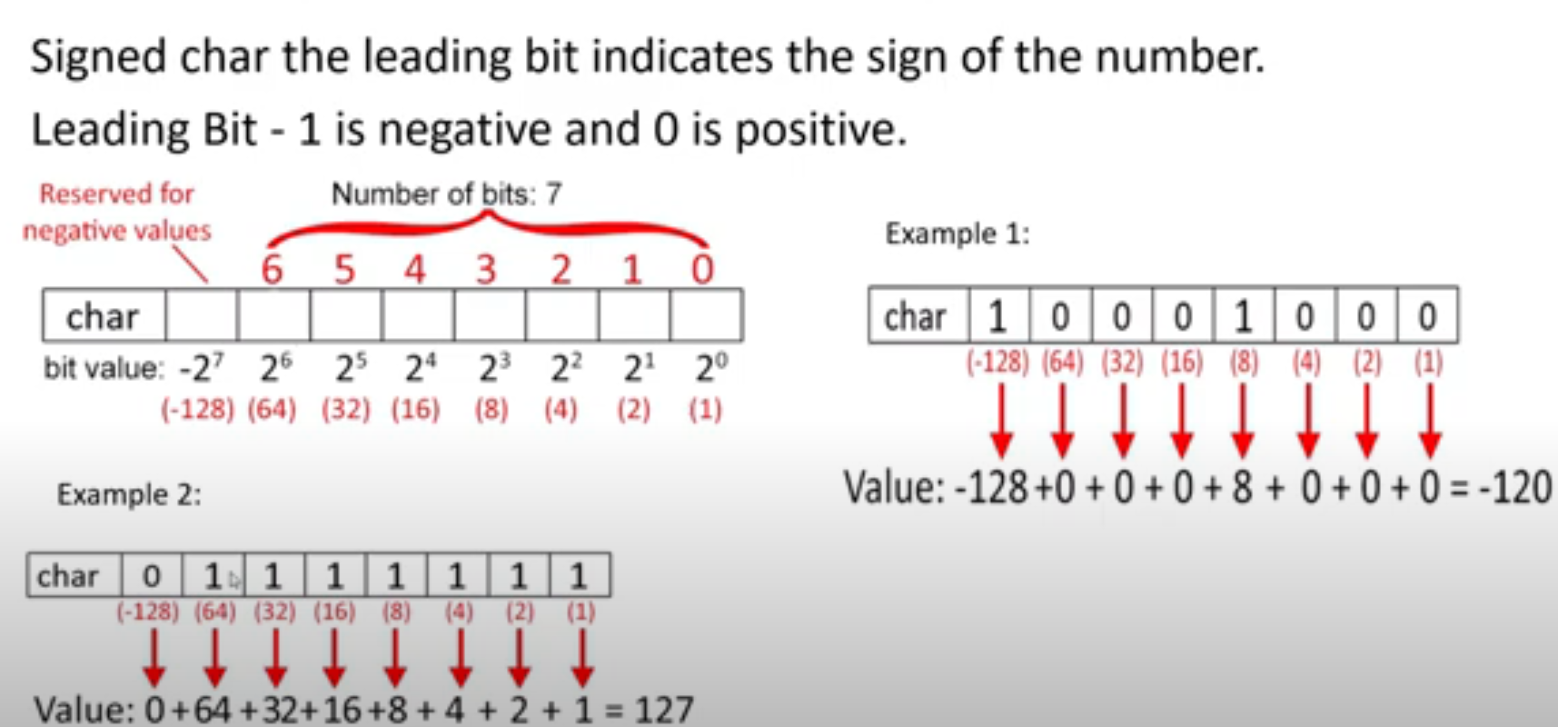
SIGNED CHARACTER:
The range of unsigned char is -128 to 127.
The first bit indicates whether it’s positive or negative.
If first bit is 1,it is negative, else , it’s positive.

Slide 20
Signed and Unsigned Numbers:
Ex: Negative number using 2’s complement method:
10 = 0000 1010
1’s complement =1111 0101
add 1 = 1
1111 0110 (-10)₂
Signed Integers: Signed integers can represent both positive and negative numbers. They are stored using two's complement representation. The signed keyword is optional, as integers are signed by default. Common types for signed integers include int, short, long, and long long.
Unsigned Integers: Unsigned integers can represent only non-negative numbers (zero and positive numbers). They use the entire range of non-negative values. Common types for unsigned integers include unsigned int, unsigned short, unsigned long, and unsigned long long. Unsigned integers can store larger positive values compared to signed integers, as they don't need to reserve a sign bit. However, they cannot represent negative numbers.

Slide 21
RANGE OF SIGNED AND UNSIGNED INTEGERS:
The range can be calculated using -2^{(n-1)} to 2^{(n-1)} -1
For a signed integer represented using 16 bits, the range is indeed from -32768 to 32767. Here's the breakdown:
With 16 bits, the highest bit represents the sign (0 for positive, 1 for negative), leaving 15 bits for the magnitude.
For signed integers, the range is symmetric around zero, with one bit reserved for the sign.
Therefore, the range of values can be calculated as follows:
Minimum value: -2^(15) = -32768
Maximum value: 2^(15) - 1 = 32767
So, a 16-bit signed integer can represent values from -32768 to 32767 inclusively.

Slide 22
For an unsigned integer represented using 16 bits:
There are no bits reserved for the sign; all 16 bits are used for the magnitude.
Therefore, the range of values can be calculated as follows:
Minimum value: 0
Maximum value: 2^(16) - 1 = 65535
So, an unsigned integer represented using at least 16 bits can store values ranging from 0 to 65535 inclusively.
Min value 0 :
Max value 65535:
0 | 0 | 0 | 0 | 0 | 0 | 0 | 0 | 0 | 0 | 0 | 0 | 0 | 0 | 0 | 0
1 | 1 | 1 | 1 | 1 | 1 | 1 | 1 | 1 | 1 | 1 | 1 | 1 | 1 | 1 | 1

Slide 23
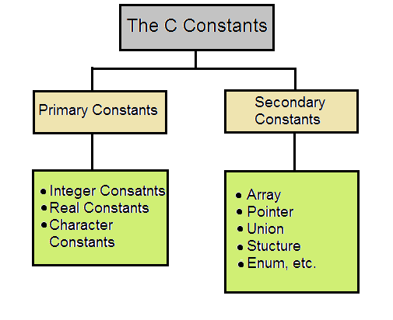
CONSTANTS
A CONSTANT is an explicit data value written by the programmer.
It is a value known to the compiler at the compiling time.

Slide 24
DECIMAL → 0-9 (Base 10) OCTAL → 0-7 (Base 8) HEXADECIMAL → 0-15 (Base 16) [ 0X, 0x , 0-9&A-F] FLOATING → Eg: 12.56 → VALID. -56.02 → VALID. 12.56.02 → INVALID . 25,000 → INVALID DUE TO COMMA . 12 34 → INVALID DUE TO SPACE. Character constant → ‘x’ Numeric constant → 5 String constant → “a”
NOTE: ASCII VALUES
5 (numerical constant) ‘5’ (character constant) LOWERCASE: a-z = 97-122
“a”(string constant) ‘a’(character constant) NUMBERS : 0-9 = 48-57
“Welcome\0” → ‘\0’ indicates the end of a string SPECIAL CHARACTERS: 0-47 , 58-64, 91-96
printf(“%d”, ’a’); → RESULT: 97 UPPERCASE : A-Z = 65-90 printf(“%c” ,97); → RESULT: a

Slide 25
VARIABLES IN C:
b
30
2000
To access any number, we can’t all the time remember it’s address location and so, the concept of variable paved the way for.
Variable is a name given to a memory location to store values.
int a ; → Declaration a =10; → Initialisation
a
10
1000
c
20
3000

Slide 26
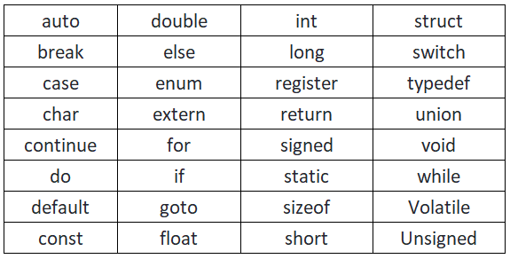
KEYWORDS/RESERVED WORDS / PREDEFINED WORDS:
Keywords are reserved words which have standard , predefined meanings in C and are used only for intended purpose.
There are 32 Keywords and all should be represented only in lowercase.

Slide 27
IDENTIFIERS
An IDENTIFIER is a sequence of characters created by the programmer to identify or name a specific object.
The first character must be an alphabetic character(lower-case or upper-case) or an underscore ‘_’.
No special symbols are allowed.
An IDENTIFIER cannot duplicate a keyword.
FIND THE PROPER AND IMPROPER IDENTIFIERS:
1. employee_number 2. box_4_weight 3. 230_item 4. tool_4 5. /profit 6. ~cost_per_item.
RULES TO BE KEPT IN MIND WHEN NAMING IDENTIFIERS:
valid valid invalid valid invalid invalid

